Slide 1
A question to consider…
You’re following the rules and listening carefully to your teacher when someone next to you starts talking to you.
You don’t want to be disrespectful and ignore them completely…
…but you also don’t want to break rule #1.
What should you do? Talk to the person next to you for a minute and try to decide.
Notes:
(Introduce L is for later)

Slide 2
What Is Science?
Year 7 Science

Slide 3
By the end of this lesson, you will be able to…
Explain what science is
Explain why people study science
Identify some common fields of science
Identify what science can and can’t do

Slide 4

What do you already know?
WHITEBOARDS
On your whiteboard, write down one thing a scientist might study.
This could be anything: the weather, plants, space, the brain, electricity…
You have 15 seconds. Go!
So if scientists study all of these different things, what makes them all scientists? Let’s think about that…
Notes:
At the end of the 15 seconds, get a few answers using popsticks and write them on the board.

Slide 5
What do scientists all have in common?
WHAT: do scientists all study the same thing?
No! We’ve already seen that scientists study all sorts of things.
WHO: is science just for grown-ups? Just for men? Just for people who speak English?
No! All sorts of people can be (and are) scientists: young and old, men and women, and people from all over the world.
WHERE: is science something that you have to do in a laboratory?
No! Science can take place indoors, outdoors, in space, underground… wherever there’s something to observe!

Slide 6

What do scientists all have in common?
WHEN: have all the major scientific discoveries already been made in the past?
No! There are still so many things that scientists don’t understand and are still working on.
WHY: do scientists all study the world for the same reason?
No! Some scientists try to improve people’s lives, some scientific discoveries are used in wars, some scientists are trying to protect the environment… and some are just curious!
So… what’s left?

Slide 7
So what is science?
Science isn’t a what, who, where, when, or why…
Science is a HOW. It involves:
We call this cycle the scientific method. You’ll be learning all about it over the next few weeks!
Testing / Observing
Measuring / Recording
Explaining
Questioning
Notes:
Give some examples of this cycle (e.g. an illness → medical research)

Slide 8
What does this mean?
Obviously, this method only works on things that can be tested and observed.
This means that not every question is a scientific question.
For example:
Can you test how good-looking you are?
Can you test whether a piece of music is beautiful?
Can you test whether it is right or wrong to use animals in medical research?
Testing / Observing
Notes:
(Rhetorical questions: actual ones next slide)

Slide 9
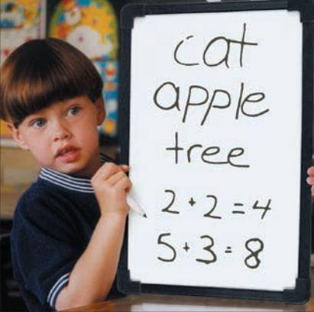
Which questions are scientific?
WHITEBOARDS
Draw two lines on your whiteboard as shown.
In the top left box, write ‘Scientific’.
In the top right box, write ‘Not scientific’.
Write the numbers of the following questions in the lower boxes depending on whether or not they are scientific questions.
When you are done, hold up your board for me to see.

Slide 10
Which questions are scientific?
WHITEBOARDS
Remember, the scientific method only works on things that can be tested and observed.
How heavy is this book?
Is pizza delicious?
Does Lynx deodorant smell nicer than Rexona deodorant?
Which species of plant grows fastest?
Is gravity stronger on Earth or on Mars?
Does drinking milk make your bones stronger?
Do people have souls?
What is the purpose of life?
Notes:
Draw table on board and demonstrate first two with those who don’t immediately understand

Slide 11
What else will you be learning?
In addition to the scientific method, we will be learning about:
Biology: the science of life and living things
Chemistry: the science of the structure, properties and reactions of matter
Physics: the science of matter and energy
Earth and Space Science: the study of the planet Earth and its place in the universe

Slide 12

Why does it matter?
Knowing about the many different areas of science helps you to appreciate just how huge, complex, and amazing our universe is!
Knowing why people study science will help you to find your own reason to do your best in your science classes.
Knowing what science is and how it works is the foundation that you will build all of your scientific knowledge and skills on – it’s important to get it right!

Slide 13
What do you remember?
Is science a what, who, where, when, why, or how?
What do we mean by this?
Give one reason why what you’ve learned today matters.
Which of the following is not a scientific question, and why not? Write your answer on your whiteboard using full sentences.
Why are leaves and grass both green?
What happens when you die?

Slide 14
Packing up responsibly
Packing up is a great opportunity to display responsibility. When you pack up you need to:
Get your stuff ready to go
Make sure anything you borrowed or used from the classroom is returned
Make sure the area around you is clean and tidy
Push in your chair and stand behind your desk
Wait quietly (not silently) to be dismissed
Notes:
Subpoint 1: you might be asked to collect the names
Subpoint 2: you might need to clean up someone else’s mess!
Subpoint 5: the bell is not binding

